Slide 1

Entity Framework Core 5

Slide 2
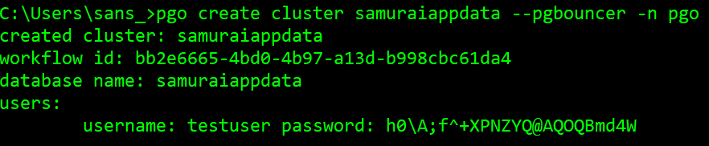
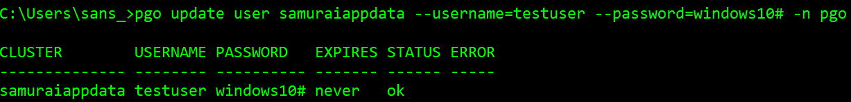
Create a database cluster in PostgreSQL

Slide 3
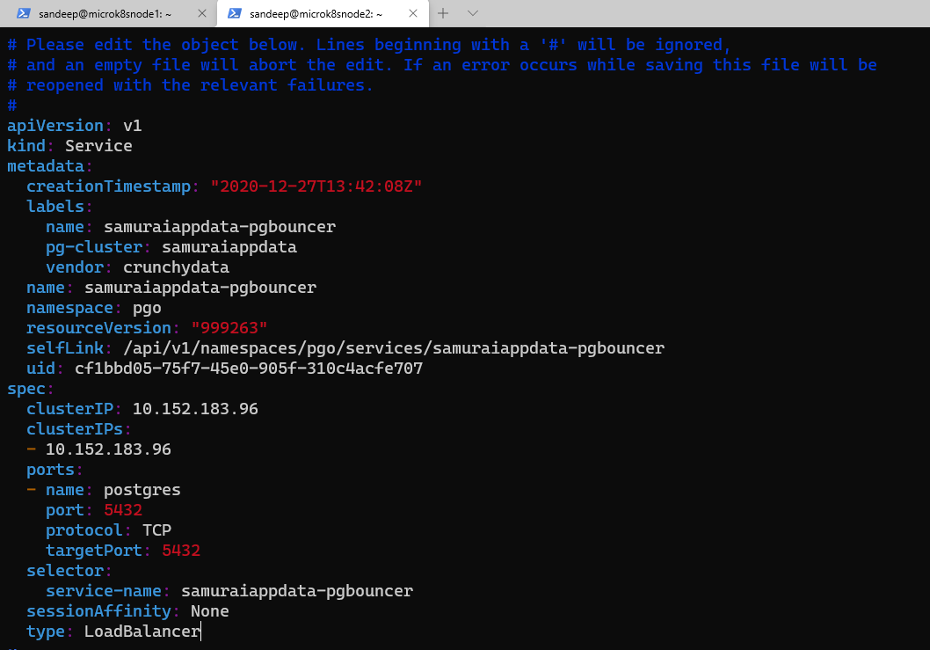
Change the samuraiappdata-pgbouncer service

Slide 4
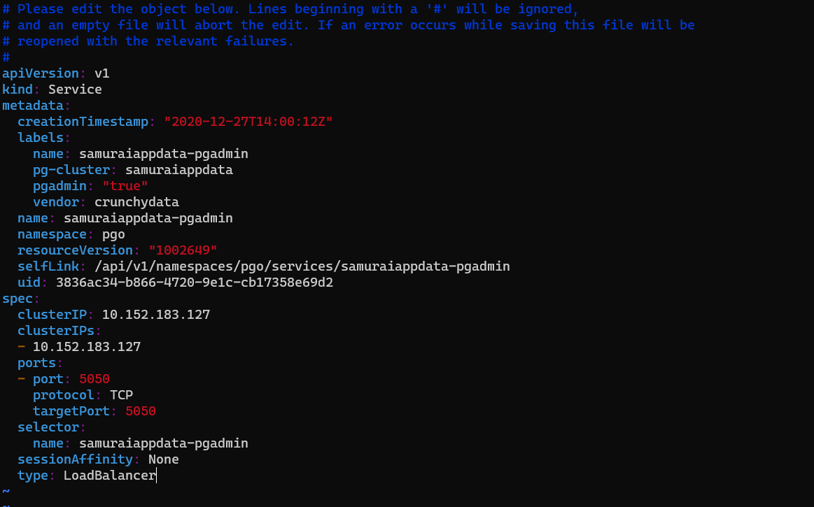
Change the samuraiappdata-PGADMIN service

Slide 5
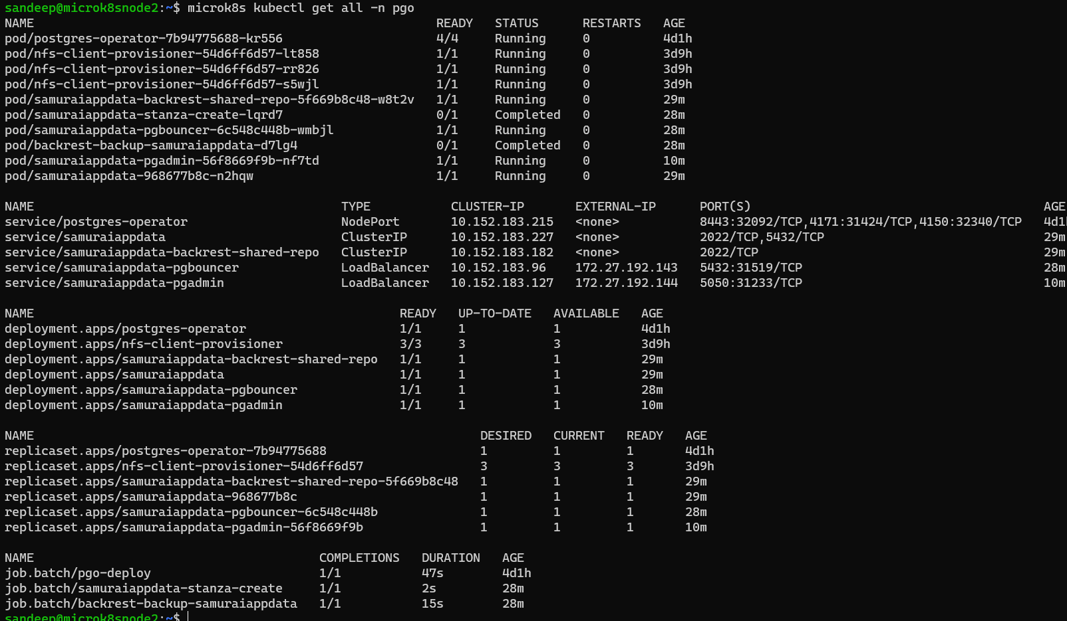
Inspect samruraiappdata services

